Slide 1

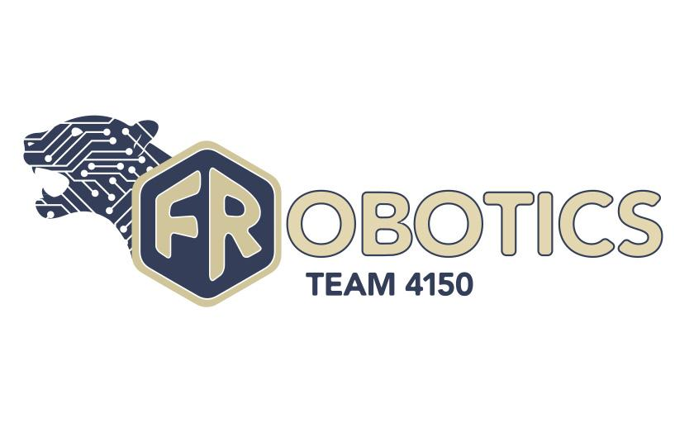
Wiring Guide
Team 4150

Slide 2
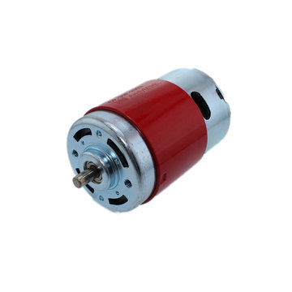
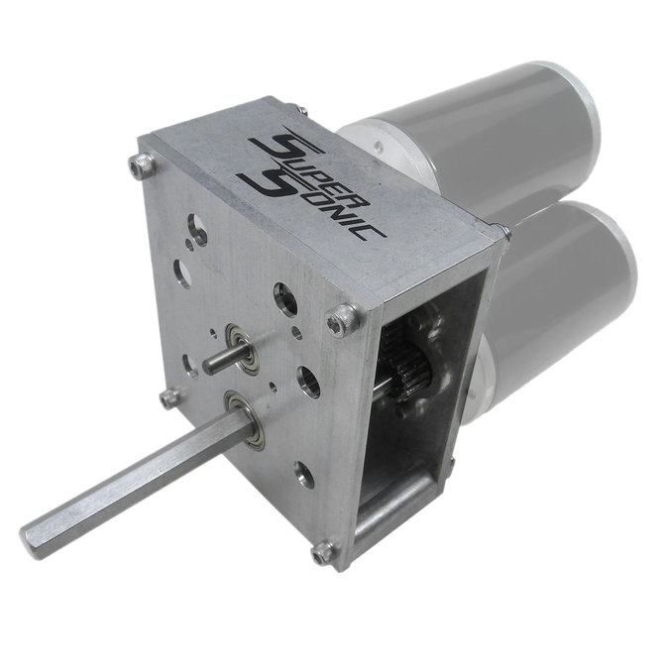
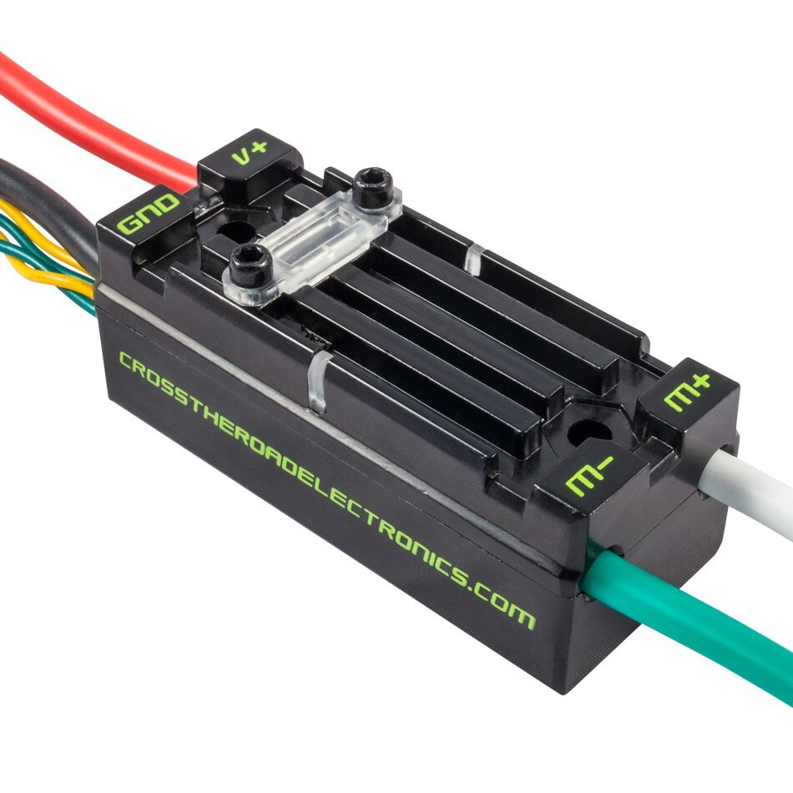
Basic Drive Base Layout
4 motors: 2 on either side of the robot chassis. Generally attached together to a single gearbox and shifter
4 motor controllers connecting each motor to the Power Distribution Board
2-4 encoders attached to the gearbox or motor shaft that are spliced with PWM cables and connected to the PWM inputs on the RoboRio (More on encoders later on and in the Useful Sensors presentation)

Slide 3
Common Wiring Board Components
Power Distribution Board (PDB): Central panel that distributes power directly from the battery to all other components on the robot.
RoboRIO: The central computer for communications and code on the robot. All communications run through here.
Pneumatics control module: Controls the compressor and solenoids, and reads the pressure gauge.
Voltage regulator module: Converts the voltage and amperage from the PDB for components that require lower than what it can provide, such as the Radio and Raspberry Pi.
Raspberry Pi: Smaller computer that is used for Camera communications.
Radio: Produces the Wifi signal to open telecommunications with the robot.
Camera: Provides an easier line of sight if thought necessary.

Slide 4
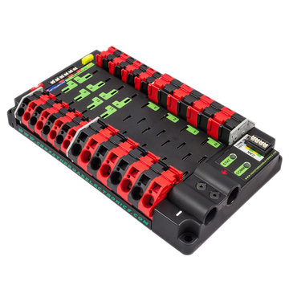
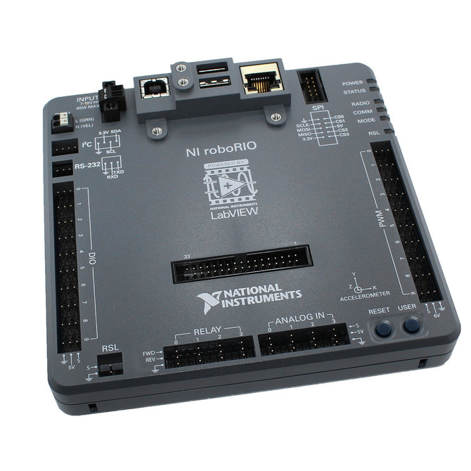
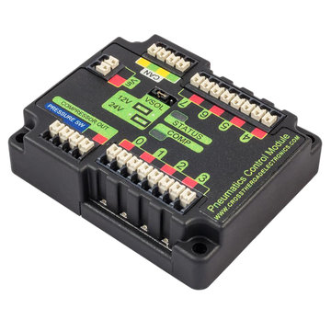
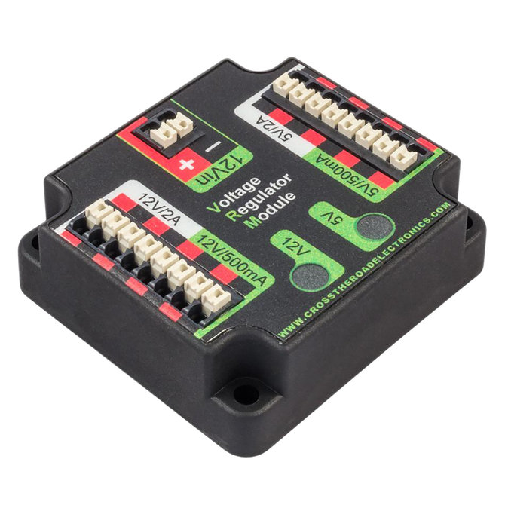
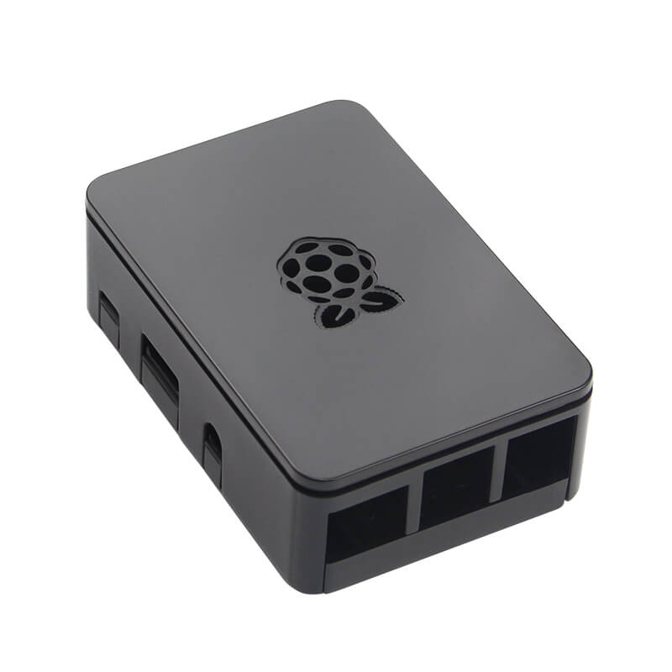
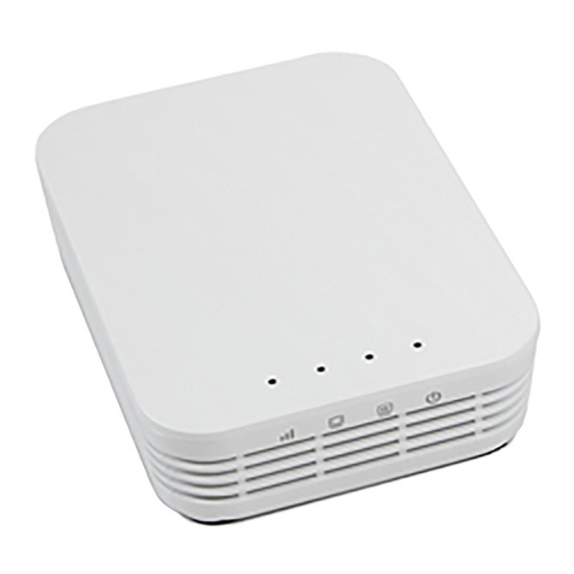
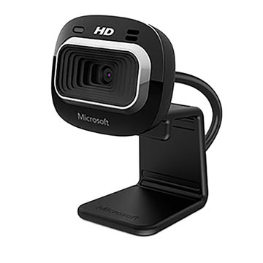
What they look like!
PDB
RoboRIO
Pneumatics Control Module
Voltage Regulator Module
Raspberry Pi
Radio
Camera

Slide 5
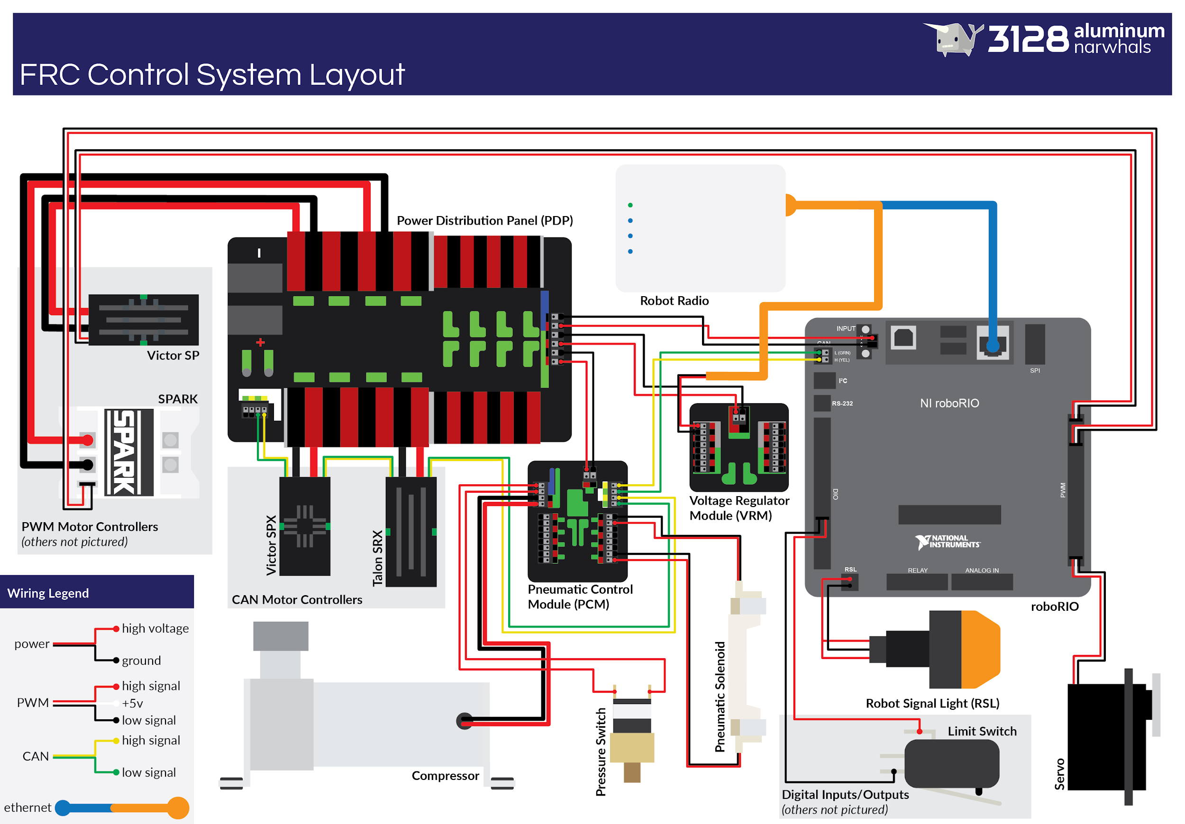
Basic Wiring Diagram
Here is an excellent wiring diagram, originally made by team 3128, that is open for public access. The only mentioned item that is not shown on this schematic would be the Raspberry Pi and its camera. More information on these can be found in the Useful Sensors presentation. The Raspberry Pi would simply connect to the voltage regulator module and RoboRIO in this diagram.

Slide 6

PDB Ports and Breakers
Top 3 Ports: RoboRIO, Voltage Regulator, Pneumatics Control
-18 Gauge wire
Small Power Ports
-16/18 Gauge wires
Breaker Sizes: 5-30 Amp
CAN Bus Termination Port
-22/24 Gauge CAN wire
Large Power Ports
-16 and lower Gauge wires
Breaker Size: 40 Amp
Battery Connection
-6 Gauge wire

Slide 7
CAN Bus
The CAN Bus is a daisy-chain of CAN communication wires connecting all systems that require the robot code from the RoboRIO to operate and provide feedback. The entire CAN Bus must be intact for the code to work for any part of the system, and it must begin with the RoboRIO and end with the PDB or alternative termination (such as a resistor). CAN wires are generally small green and yellow wires and should be twisted around each other as much as reasonably possible for stronger communication.
Start
Finish

Slide 8
Expanding Past the Basics
The RoboRIO has ports labelled DIO and PWM that are used quite frequently, with the others being related to specific sensors. For specific pin-outs, reference the Useful Sensors presentation.
DIO stands for Digital Input/Output. This is where most general sensors will plug in to provide feedback.
PWM stands for Pulse-Width Modulation. This is where any component entirely operating on a PWM wire, such as electrical servos, will plug into. PWMs have 3 parts, a power, ground, and signal wire.

Slide 9
Encoders and Modules and Motors
Fun with encoders! - Have you ever just wished your encoder could do all the calculations and work for you? Well now you can! With the use of a motor controller and a suitable encoder Breakout Board, you can attach your encoder wires directly to the board and motor controller. This lets you calculate the actual speed of your motors, so instead of turning voltages into speed, you can directly program the speed of your motors.
Even More Pneumatics? - If you find yourself in need of a whole second Pneumatics Control Module to account for the amount of solenoids you have, you should know that you cannot splice it off of the other one, and you also can’t create a third port in the top of your PDB, so don’t get any funny ideas. According to inspection rules, you are allowed to connect your second PCM to a smaller PDB port with a 20 Amp breaker if you really need to.
More motors and where to put them - Fun Fact #atleast3bynow! - If you manage to take up all 8 motor controller ports on your PDB, have no fear! Always keep track of the amperage requirements for the motors you’re working with. Quite often, if it’s not on the drive base, you can actually use a 20 amp breaker and use the smaller ports instead.

Slide 10
Credits
This lesson was written by FRC 4150 in partnership with FRC 8027 for FRCTutorials.com
You can contact the author at froboticsteam4150@gmail.com.
More lessons for FIRST Robotics Competition are available at www.FRCtutorials.com
This work is licensed under a
Creative Commons Attribution-NonCommercial-ShareAlike 4.0 International License.

